Slide 1
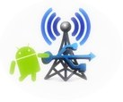
TETHER TRANSPOSE
DIVYANSHU BHARTIYA (10250)
VAIBHAV (10780)

Slide 2



AIM & Features
Sharing of laptop’s internet on the smartphone over USB
Should be able to use browser and all applications on the smartphone
Traffic Counter
Generating Log for user

Slide 3
Motivation
You can't do tethering over wifi, for example, your company doesn't let you make any hotspot at work
You don't want to spend money for a mobile plan, and you want a more stable and faster Internet connection than wifi
You don't want your PC and your Android to drain battery because of wifi
You don't have mobile/wifi network and your PC doesn't have any wifi adapter
You want your Android charged while in use
Play Store and some other applications don’t open when using Connectify.
Hotspot creation and sharing of internet is not always possible and troubleshooting is required.

Slide 4
CHALLENGES
We need to make system calls, since we are changing at the OS level.
Compatible with both windows and linux

Slide 5
Requirements
Wired internet connection to PC
Android phone with tethering supported
Android phone must be ROOTED
USB Cable

Slide 6
Design
Logical view
ANDROID
rndis0
USB
usb0
LAPTOP
Terminal Emulator
netcfg & ip binaries
Internet connection
Internet sharing
Tethering

Slide 7
Design
Process view (Android Phone)
Traffic Counter
Get USB0’s IP
Ping Successful
Make IP the default gateway route
Successful
Reverse Tethering successful
Enable Tethering
Unsuccessful
Ping Unsuccessful
Successful
Reverse tethering failed
Configure RNDIS0 to DHCP
Set DNS
Unsuccessful

Slide 8
Design
Process view (Laptop)
Login as Root
Enable port Forwarding
Enable internet sharing

Slide 9
Design
Physical View
Application
Android device
Laptop
USB cable
Internet Connection
Tethering
Terminal Emulator

Slide 10
Design
Developer’s View
System calls module
Script for Internet sharing
Traffic Counter
Application Activity

Slide 11
Implementation
Android ADT on Eclipse IDE
Traffic Counter
Both static ip and dhcp configuration
RootTools.jar used for running root commands on android

Slide 12
Test
Checked on both rooted and non rooted phones
Validation of USB plugged is made
Validation of binaries and tethering support is made
Validation of gateway by ping
Most of the applications work
Works on both Windows and Linux

Slide 13
SNAPSHOTS

Slide 14
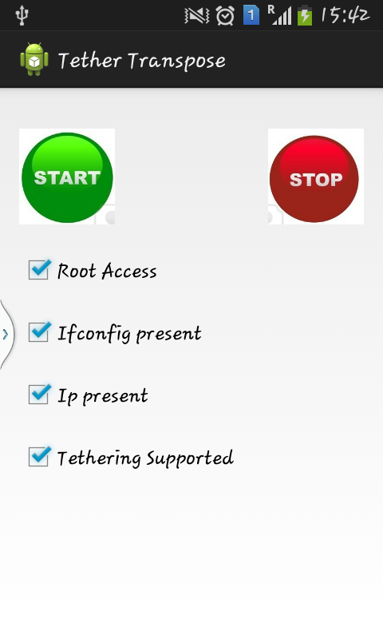
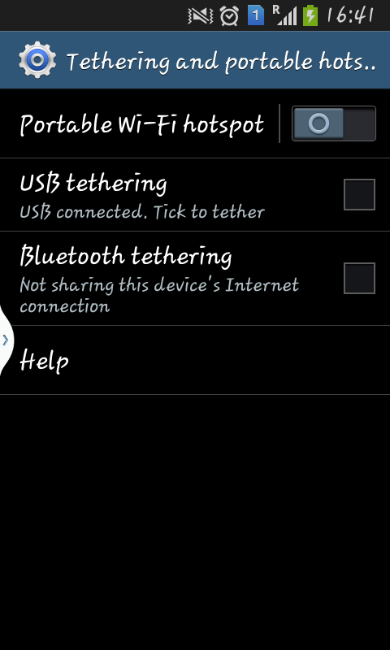
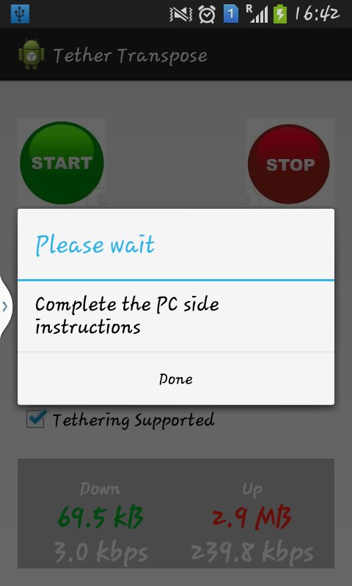

Slide 15
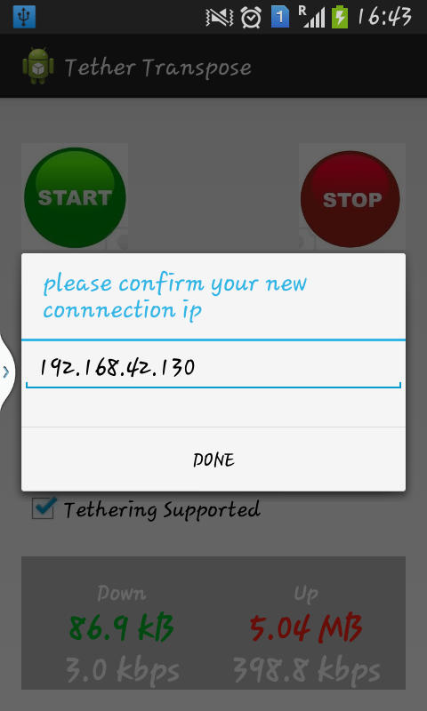
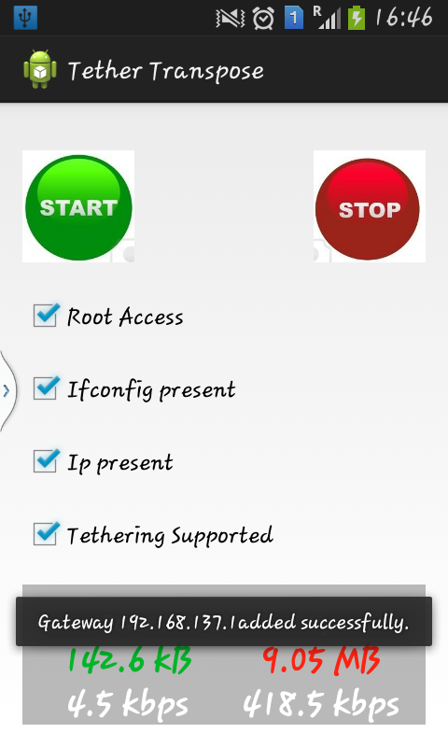
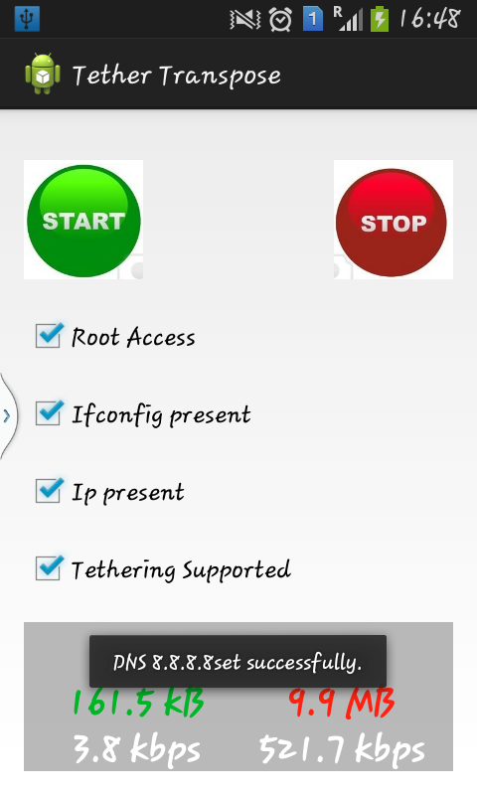

Slide 16
Further work
Addition of log facility
User friendly view for PC side setup

Slide 17
Thank You
Questions ??

